Slide 1
GENOA_AA Data Analysis
Lulu Shang
Department of Biostatistics
University of Michigan

Slide 2
Outline
Part 1: Gene expression quality control
Part 2: eQTL mapping Analysis

Slide 3
Previous work in QC
GeneChip™ Human Transcriptome Array2.0
Featured with gene-level expression profiling and detect different transcript isoforms produced by a gene.
Expression Console Software
Provides signal estimation and QC functionality for the GeneChip Expression Arrays.
Affymetrix Power Tools (APT)
A set of command-line tools for analyzing microarray data. Not commercial. Could handle large sample size, normalize all our samples at once.

Slide 4
Subject level QC
1208 out of 1233 samples passed the QC criteria recommended by Affy Expression Console
1 out of 25 failed due to low pos_to_neg_aoc
24 out of 25 failed due to perturbed polya_spike probeset control
In the 1208 samples, found 5 duplicated IDs, 3 were actually failed sample (they were removed), 2 were mislabeled (they were corrected)
Now we have 1205 samples

Slide 5
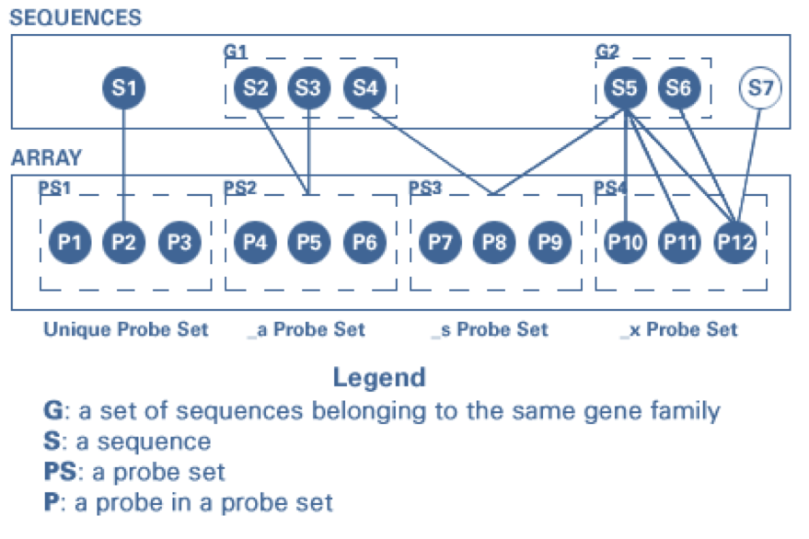
Probeset level QC
Problems we met previously:
Some probesets are mapped to multiple genes
Notes:
Multiple probe sets mapping to the same gene in Affy:
alternative splicing,
alternative ploy(A) signals,
or just incorrect annotations
Same probeset mapping to multiple genes:
e.g. Entrez Gene IDs -
things that were once thought to be different things
end up being the same thing
and one or more Entrez Gene IDs get retired.

Slide 6
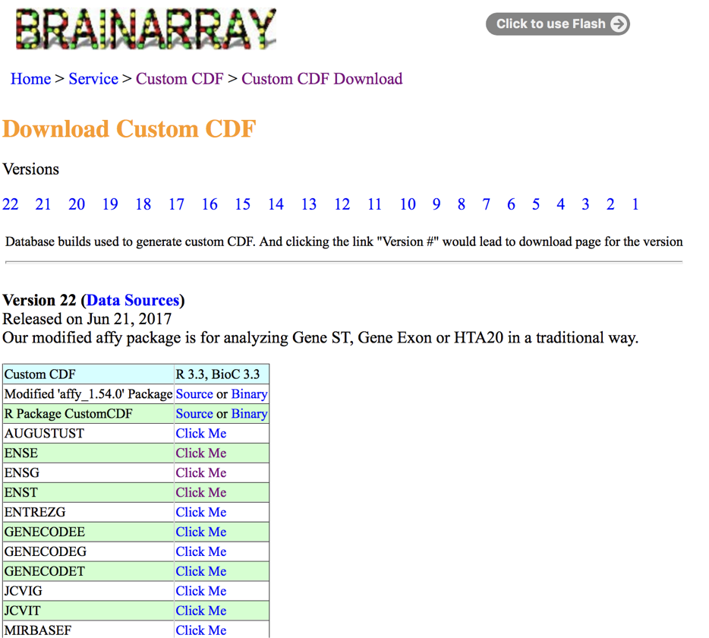
Solution: use custom CDF annotation in APT
Website:
http://brainarray.mbni.med.umich.edu/

Slide 7
Gene level results
Using custom CDF annotation, we have expression of 35,345 genes across 1205 individuals
34,453 genes have annotations in bioMart R package (e.g., start/end position, basic description)
32,955 genes are on autosomes
Our following eQTL analysis is based on the 32,955 genes.

Slide 8
Compare with results without using custom CDF
The following procedures were done before we found the easy solution for multiple mapping:
70,523 probesets extracted from APT
Remove 1500 control probesets. (68,993 left)
Remove probesets that mapped to multiple genes. (43,208 left)
Selected probesets according to the detection P value < 0.05 across >90% samples. (37,209 left)
Annotate genes with low variance across samples (<10th percentile)
Mapped to 29,260 genes using R package “BioMart”

Slide 9
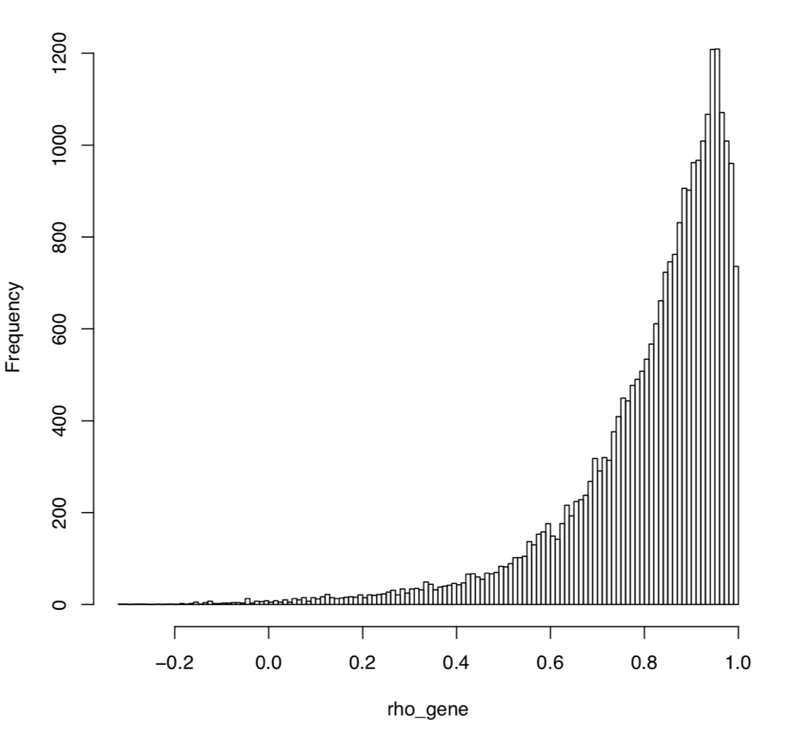
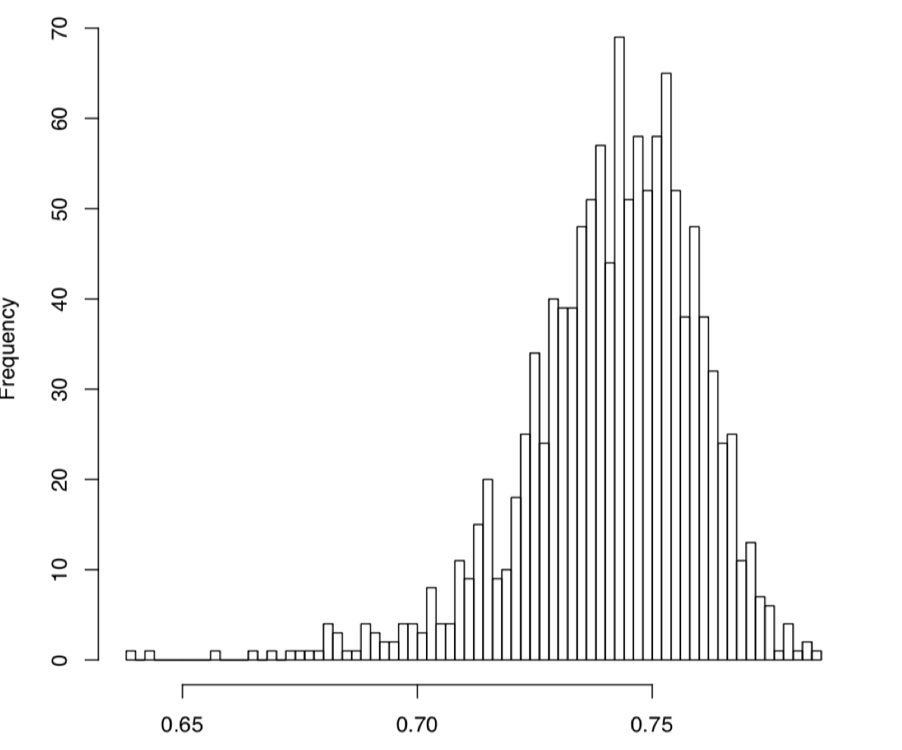
We compared the gene expression between these two datasets by genes (left) as well as by subjects (right).
Xaxis: Spearman correlation coefficients across genes and individuals; Yaxis: Frequency

Slide 10
Transcript level results
Using custom cdf annotation, we have expression of 158,625 transcripts across 1205 individuals
149,870 transcripts have annotations (start/end position, description)
138,427 transcripts are on autosomes

Slide 11
Files to use
Main Folder:
/home/skardia_lab/club_house/research/projects/GENOA_AA_GE/preprocessing_zxu_March2017/Lulu_Mar2018/
Gene expression:
Raw data from APT: /APT_results/gc-sstgl-rma-sketch.summary.txt
Raw expression matrix: mtx_Mar_gene35345.txt
Expression with annotated genes : mtx_Mar_order_32955.txt
Expression after removing batch effects: mtx_Mar_combat_32955.txt
(For this version, batch effects were removed using Combat)
Gene annotation: gene_annot_32955.txt
Transcript expression:
Raw data from APT: /APT_Transcript_results
Expression with annotated transcripts: mtx_Mar_order_138427.txt
Expression after removing batch effects: mtx_Mar_combat_138427.txt
Transcript annotation : transcript_annotation_138427.RData

Slide 12
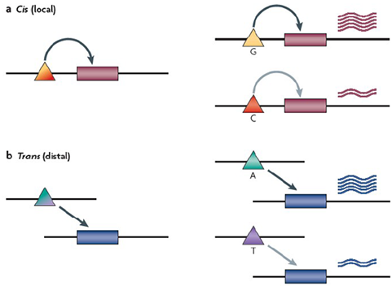
eQTL analysis
eQTLs: genomic regions that carry one or more DNA sequence variants that influence the expression level (typically mRNA abundance) of a given gene.
For each gene select a subset of SNPs and test for association:
gene expression ~ genotype + covariates + random effect
Notes:
Outcome gene expression~ snp
cis-effect:
The genetic variant in an individual directly affects the expression of its associated gene
trans-effect:
Gene expression is affected through possibly complex effects in which the genetic variant is involved

Slide 13
Which ingredients are needed?
For each sample we need:
- Genotype data
- Gene expression data
- Covariates (gender, age,…)
We also need pedigree information for the samples.

Slide 14
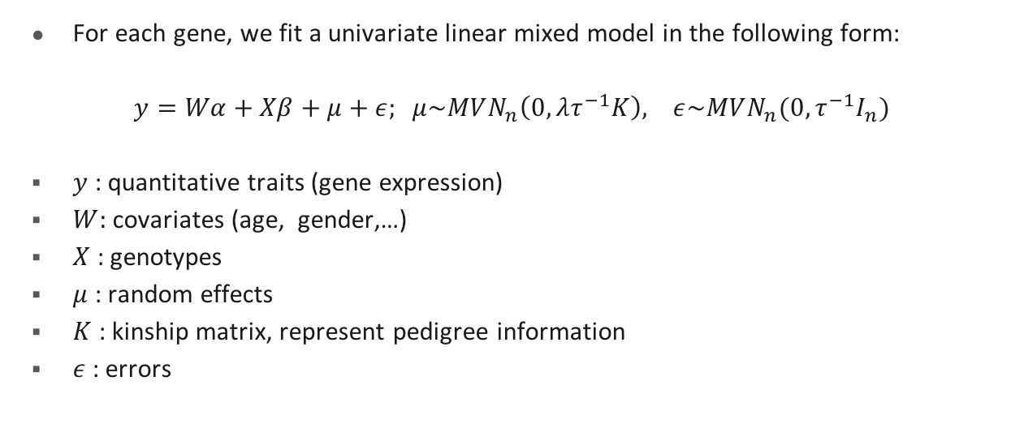
Our model:
For each gene, we fit a univariate linear mixed model in the following form:
$y=Wα+Xβ+μ+ε; μ\sim MVN_{n}\left(0,λτ^{−1}K\right), ε\sim MVN_{n}(0, τ^{−1}I_{n})$
$y$ : quantitative traits (gene expression)
$W:$covariates (age, gender,…)
$X$ : genotypes
$μ$ : random effects
$K$ : kinship matrix, represent pedigree information
$ε$: errors
We use GEMMA to run this model.
Notes:
$τ^{−1}$ is the variance of the residual errors.
$λ$ is the ratio between the two variance components.
GEMMA tests the alternative hypothesis H1 : β ̸= 0 against the null hypothesis H0 : β = 0 for each SNP in turn, using one of the three commonly used test statistics (Wald, likelihood ratio or score).
GEMMA obtains either the maximum likelihood estimate (MLE) or the restricted maximum likelihood estimate (REML) of λ and β, and outputs the corresponding p value.
In addition, GEMMA estimates the PVE by typed genotypes or “chip heritability”.

Slide 15
Genotype data preparation
SNP data in IMPUTE2 format: /home/skardia_lab/club_house/research/projects/GENOA_GWA/Data/GENOA_Phasing_Oct_2012/Jack/SNPTEST/
Info score: /home/skardia_lab/club_house/research/projects/GENOA_GWA/Data/GENOA_Phasing_Oct_2012/Jack/Annotation/Jack1599fwd_Hg19.anno
Filtering criteria
- Use SNPs within +/- 100kb of the range of a gene (we use cis-eqtl)
- MAF threshold: > 0.01 in all three MAFs
- Info score: > 0.4 in all three kinds of scores

Slide 16
Gene expression data preparation
Gene expression data
- 1032 individuals overlapped with 1599 individuals in genotype data
- Removed batch effects using R package “Combat”
Notes:
- Get residuals from linear model Expression~ age + gender, do quantile normalization

Slide 17
Kinship matrix preparation
Potential problem: population admixture in the AA dataset.
Solution: calculate kinship matrix using PC-Relate function in R package “GENESIS”.
- Use the ancestry representative principal components (PCs) to adjust for the population structure
- Provide accurate estimates of recent genetic relatedness due to family structure.
Notes:
A standard PCA is performed on this “unrelated subset” of individuals, and PC values for the excluded “related subset” of individuals are predicted from genetic similarity.
PC-Relate uses the ancestry representative principal components (PCs) calculated from PC-AiR function to adjust for the population structure and ancestry of individuals in the sample and provide accurate estimates of recent genetic relatedness due to family structure.

Slide 18
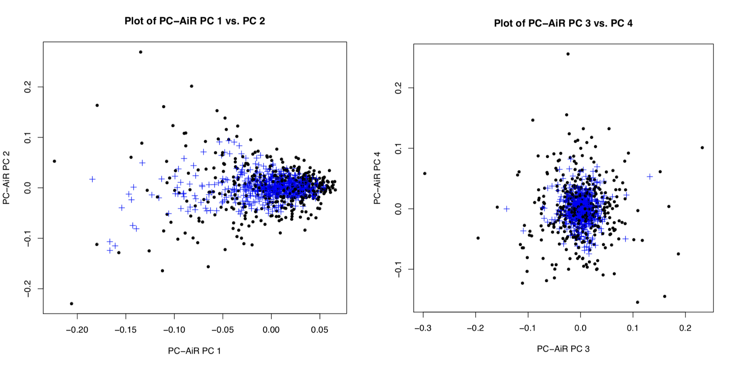
Plot of PC-AiR, PC1 vs. PC2 (left), PC3 vs. PC4 (right)
Black dots and blue pluses are for individuals in the “unrelated subset” and “related subsets” respectively.
Notes:
PC-Relate uses the ancestry representative principal components (PCs) calculated from PC-AiR to adjust for the population structure and ancestry of individuals in the sample and provide accurate estimates of recent genetic relatedness due to family structure.
The default is to plot PC values as black dots and blue pluses for individuals in the “unrelated subset” and “related subsets” respectively.

Slide 19
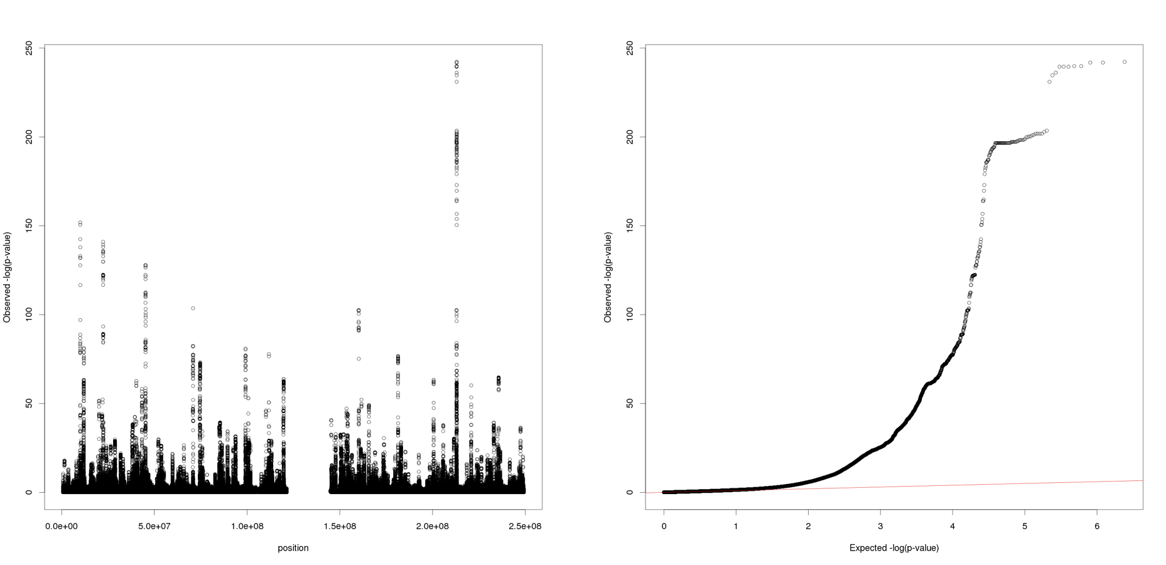
Preliminary Results
Left: -log10(p_value) vs. SNP position on chr1
Right: QQ plot of -log10(p_value) on chr1
We got similar strong signals on all chromosomes.

Slide 20
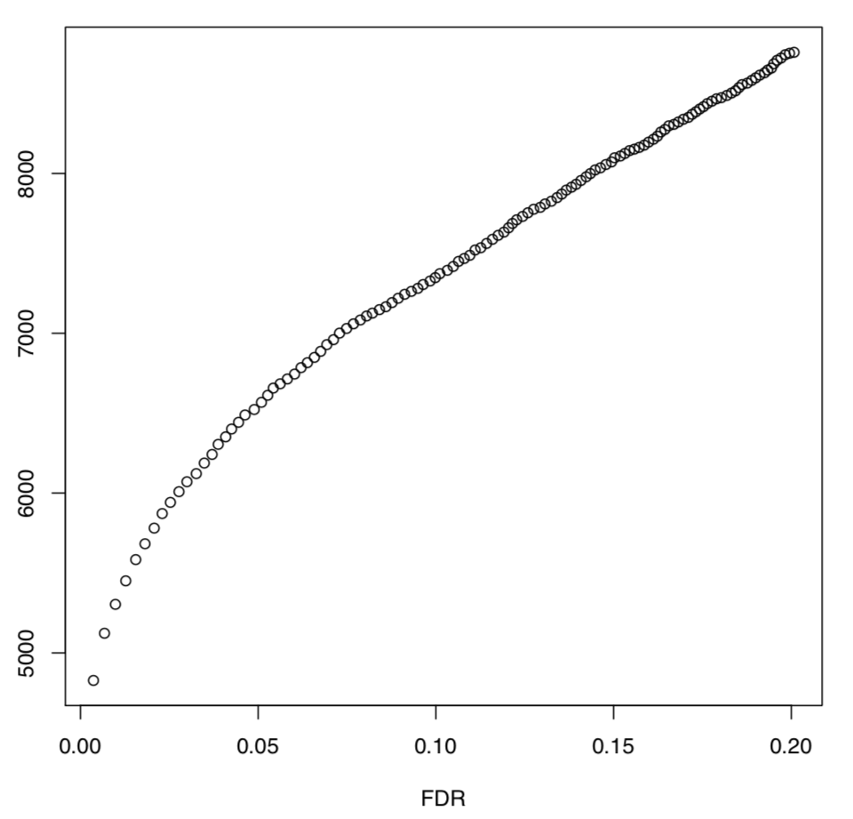
Number of eGenes at different FDR
“eGenes” are genes with at least one SNP in cis significantly associated, at a fixed false discovery rate (FDR)
Estimates of the FDR: 10 permutations, permutation of sample labels
eGenes number

Slide 21
Number of eGenes at different FDR
FDR | Number of eGenes | P value threshold
1% | 5451 | 0.8*1e-5
2% | 5781 | 1.4*1e-5
5% | 6568 | 4.2*1e-5
10% | 7373 | 9.8*1e-5
20% | 8758 | 2.48*1e-4
At 5% FDR, we identified 435,201 eQTLs and 359,330 eSNPs.
Total test we did: 25,461,943
eQTLs : 1.7%

Slide 22
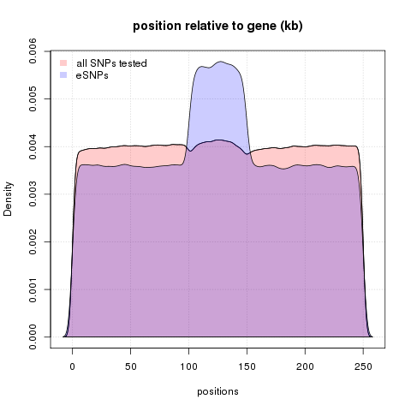
eQTLs are enriched in and near genes
Notes:
eSNPs are overplotted in purple, and are enriched, relative to all SNPs tested, near TSS, TES, and within gene bodies.
SNPs that fall outside of one focal gene may fall within the boundaries of other genes.
We rescaled the SNP positions within a gene since genes have different length. SNP density within genes cannot be directly compared with SNP density outside of genes.

Slide 23
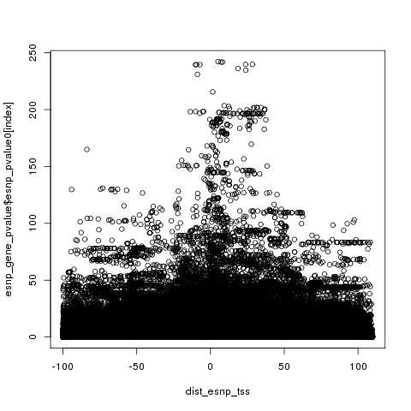
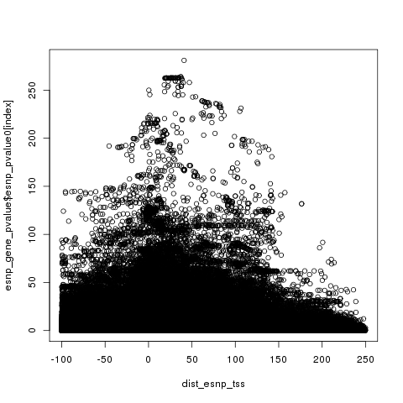
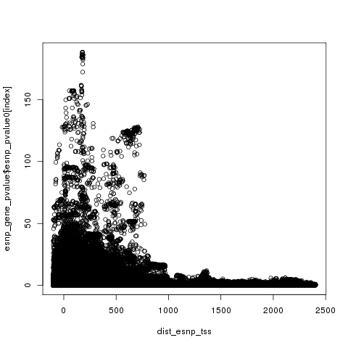
eQTLs are enriched near TSS and TES
Small genes (gene length <10kb, 15.5%)
Medium genes (gene length <150kb, 60.3%)
Large genes (gene length >=150kb, 24.2%)
Xaxis: distance to TSS
Yaxis: -log10(p_value)
This is plot of –log10(p_value) for the eQTLs relative to the distance to TSS in small, medium, and large genes. We can observe enrichment of signals near TSS. Similar observations can be found near TES.
Notes:
+ plot according to MAF

Slide 24
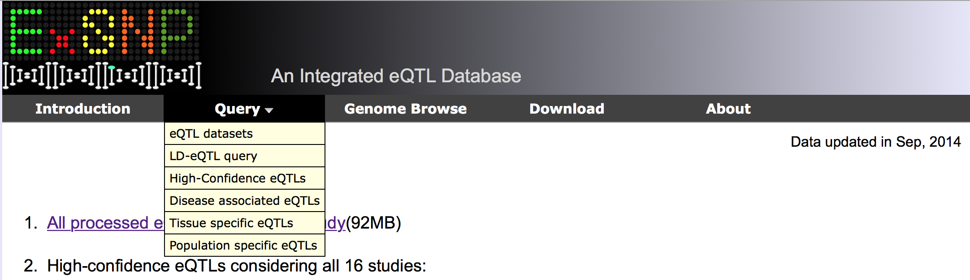
Compare with results from previous studies
Notes:
The majority of the cis eQTLs identified were specific to the condition tested. The authors also identified trans eQTLs and condition-specific gene networks. In a second study, Nir Hacohen and colleagues report eQTL mapping of dendritic cells isolated from the peripheral blood monocytes of 560 healthy individuals of European, Asian or African-American ancestry from the PhenoGenetic cohort (Science 343, 2014, doi:10.1126/science.1246980). They identified 264 cis eQTLs for resting dendritic cells.

Slide 25
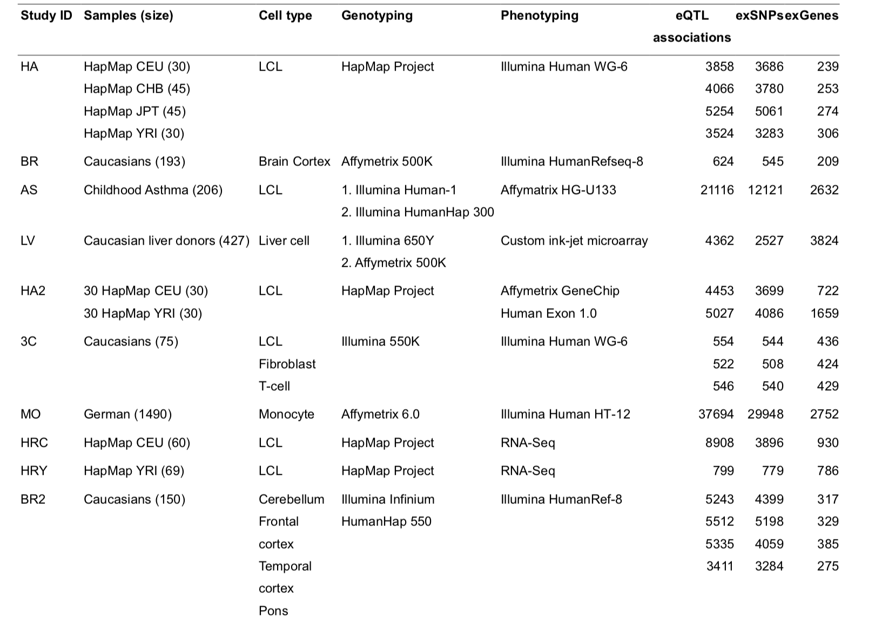
Notes:
http://www.exsnp.org/image/Dataset_Table.pdf

Slide 26
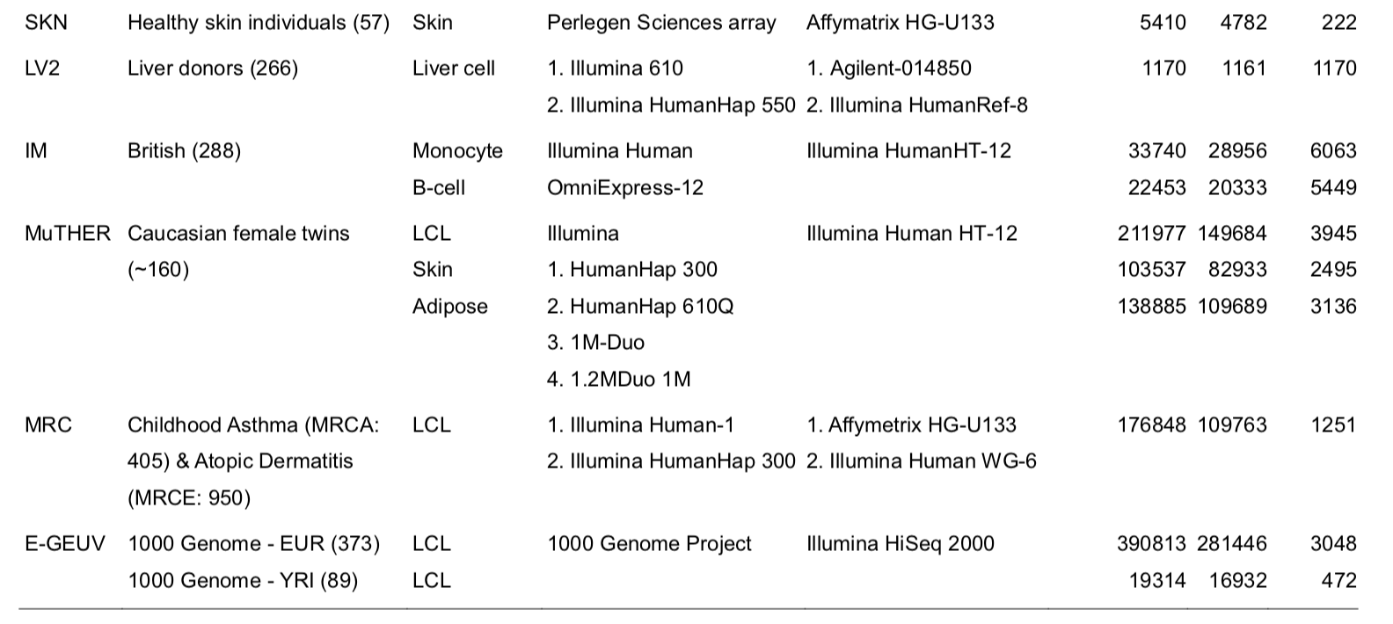

Slide 27
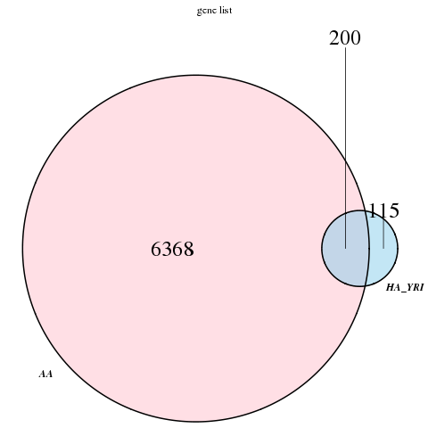
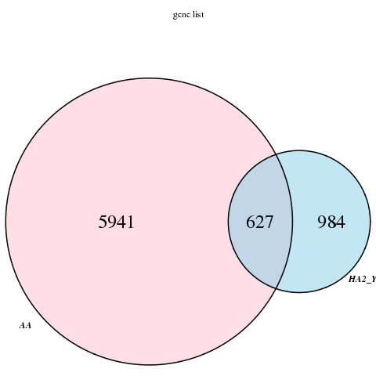
AA vs. Hapmap_YRI_illumina in 2007
AA vs. Hapmap_YRI_affy in 2007
(73)
(808)
In the 115 genes from Hapmap YRI
that don’t overlap with our results,
we tested 73 of them in our analysis.

Slide 28
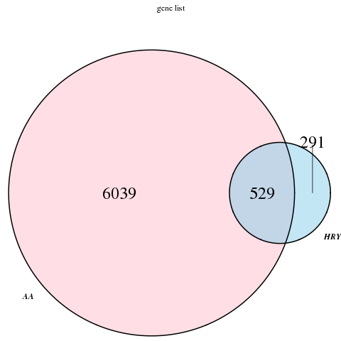
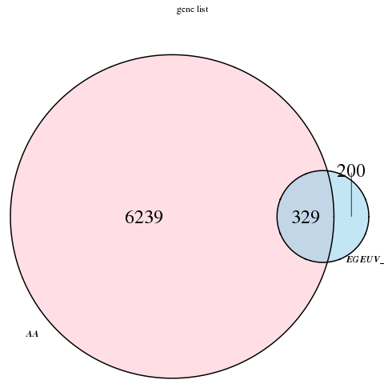
AA vs. Hapmap_YRI in 2010
AA vs. 1000 Genome YRI in 2013
(160)
(82)

Slide 29
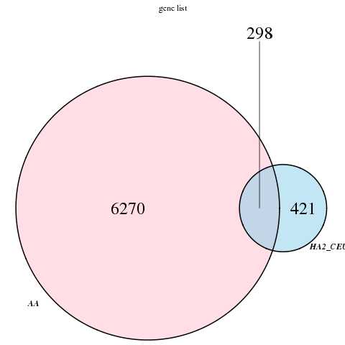
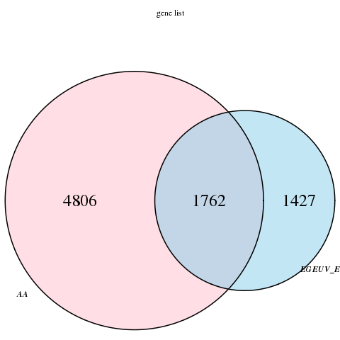
AA vs. Hapmap CEU in 2010
AA vs. 1000 Genome EUR in 2013
(344)
(919)
Notes:
CEU
Utah Residents (CEPH) with Northern and Western European AncestryEUR

Slide 30
Future work
Add PCs which represent population structures into our linear mixed model.
Compare our results from AA with results from EUR.
Notes:
Check other papers, if they controlled population structure.
Compare with other AA data results, where they publish, genome biology, american journal of human genetics
+pc, results refined

